Slide 1
DBSCAN
A Density Based Clustering Method
Liam Haas-Neill; November 30, 2018
https://towardsdatascience.com/the-5-clustering-algorithms-data-scientists-need-to-know-a36d136ef68

Slide 2
DBSCAN
Density
Based
SCAN
Spatial
Clustering of
Applications with
Noise

Slide 3
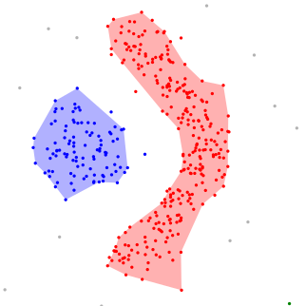
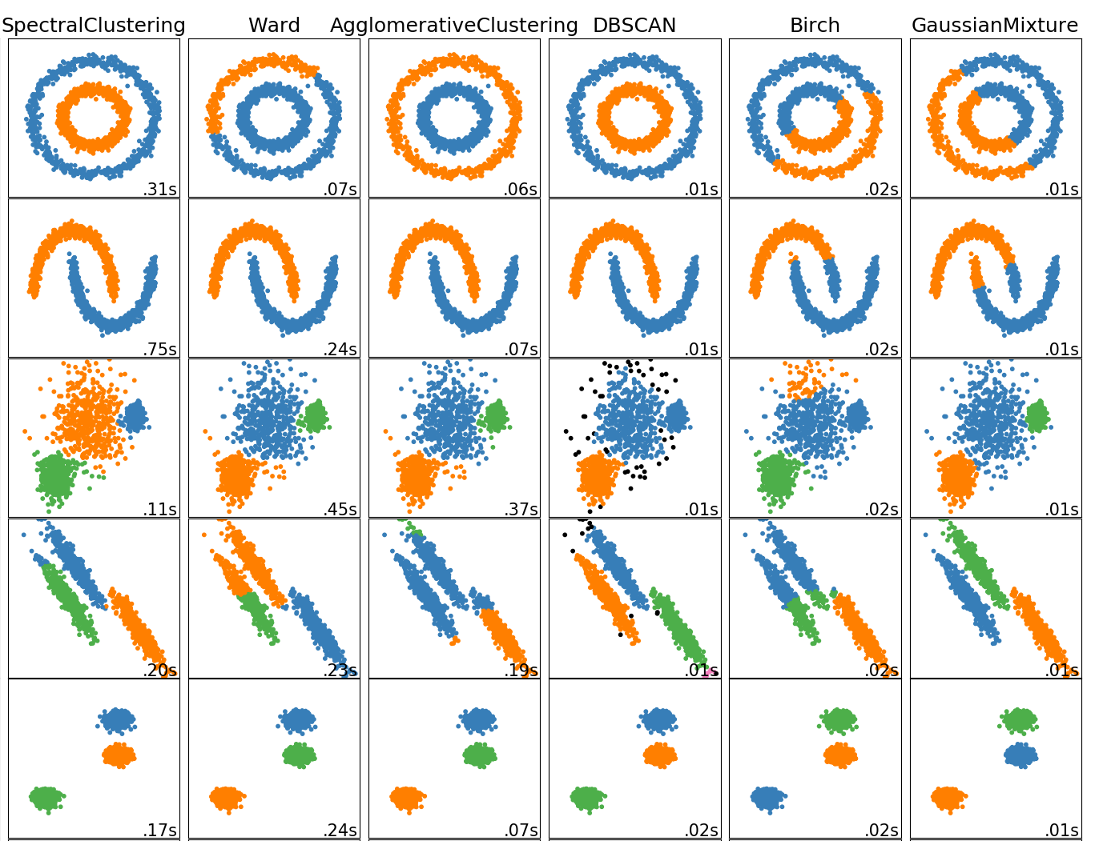
DBSCAN clusters points that are connected to each other by regions of high density data
https://en.wikipedia.org/wiki/DBSCAN#/media/File:DBSCAN-density-data.svg
https://scikit-learn.org/stable/auto_examples/cluster/plot_cluster_comparison.html

Slide 4
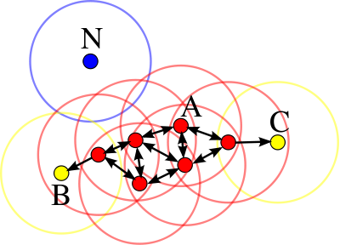
Some Terms
Core point: a point which is close to a lot of other points
Directly Reachable Point: A point that is close to the point you are looking at
Reachable Point: A point that is connected to the point you are looking at by a path of directly reachable points, and is not a core point
Outlier: A point that is not reachable from a core point
https://en.wikipedia.org/wiki/DBSCAN

Slide 5
Hyperparameters
d – distance which defines what it means for a point to be “close”
The circle at point P with radius d is called the neighbourhood of the point
Nmin – number defining the minimum number of points in the neighbourhood of a point for it to be considered a core point
https://en.wikipedia.org/wiki/DBSCAN

Slide 6
Better Terms
Core point: a point which has at least Nmin neighbours a distance of d or less away
Directly Reachable Point: Point Q is directly reachable from point P if |Q-P|<d
Reachable Point: a point Q is reachable from core point P if there exists a path of n points p(i), such that p(i+1) is directly reachable from p(i), and P=p(1) and Q=p(n)
Outlier: A point that is not directly reachable from a core point
https://en.wikipedia.org/wiki/DBSCAN

Slide 7
The Algorithm
Pick d and Nmin
Visit an unvisited point
Determine if it is a core point
If it is not: label as noise, move to new point
If it is: add it and its nearest neighbours to a cluster
Select a new point and repeat
Runtime: O(n²) ; Clever stuff: O(nlogn)

Slide 8
Advantages
Don’t need to specify N-Clusters
Finds arbitrary shaped clusters
Robust to noise, finds outliers
Only 2 hyperparameters

Slide 9
Disadvantages
Border points don’t have a determined cluster when they are reached by 2 core points of different clusters
Dependent on distance measure
Cannot clusterize with data containing “clusters” of widely varied density
Can be difficult to choose Nmin & d

